Slide 1
E&P Update 11/30

Slide 2
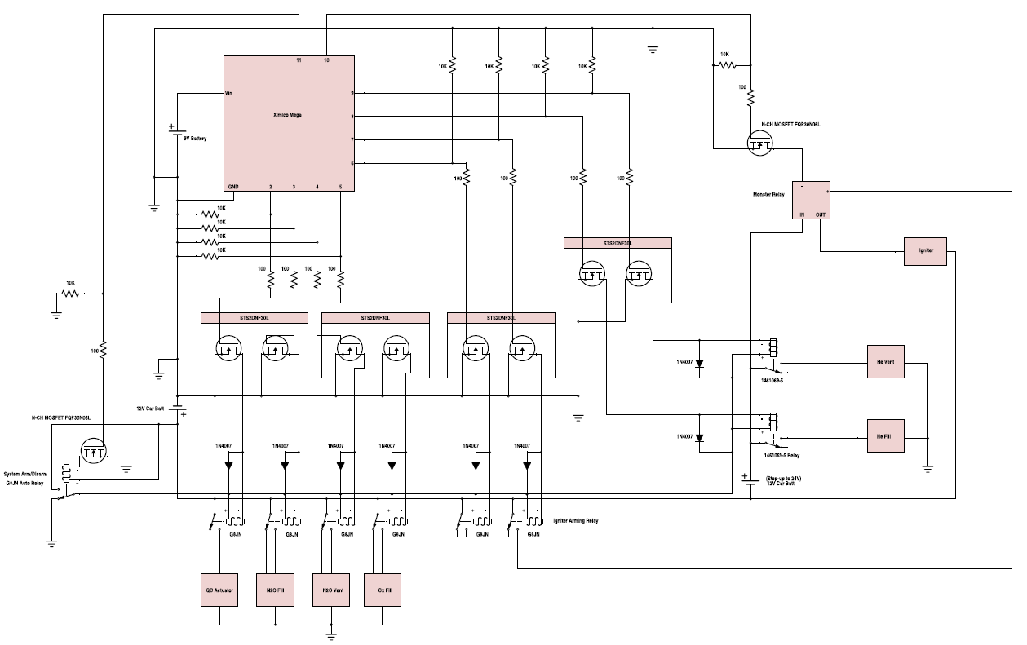
Launch Box
New Schematic – Double igniter arming
Ready to order components

Slide 3
Avionics Tower
Avionics bay will attach to bulkhead above with 3 metal bolts and spacers
New vibration-dampening bolts and bay attachment modeled in CAD
“The remainder of my time was spent assisting with the launch box which less than super fun.”

Slide 4
Wireless Transmission and Data Collection
2.4 GHz Yagi Antenna should be fine with FCC (but it may be wise to check with a lawyer)
Data Collection
20 Hz equivalent sampling rate required for T/C, strain gage, IMU, and pressure transducer
2 Arduino Megas can handle data collection demand
Data storage (to be tested this week)
SD Card
EEPROM Chip

Slide 5
Launch Box (Backup)

